Slide 1
WINDOWS FORMS

Slide 2
Objectives
Basics of desktop application
How it is different from a web application
How to create a basic windows forms application with controls and event handler
Validation
Data binding
Using data binding controls with windows forms

Slide 3
Introducing Windows Forms
The user interface provides a mechanism for users to interact with an application. Efficient design of the user interface with an eye towards ease of use is of paramount importance when creating an application.
The end users are commonly called the “target audience”.
A well designed user interface makes it easy for the target audience to learn and use the application.
A poorly designed user interface, on the other hand, can lead to frustration and ultimately inefficiency as the application is avoided or even discarded
The primary element of a Microsoft Windows application is the form.
Forms provide the foundation for each level of user interaction.
Controls and menus can be added to provide specific functionality

Slide 4
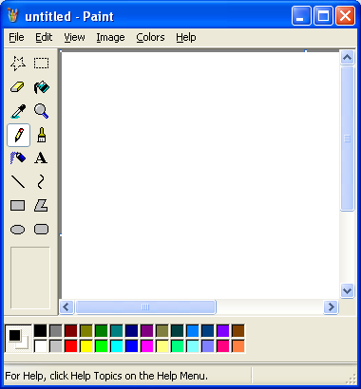
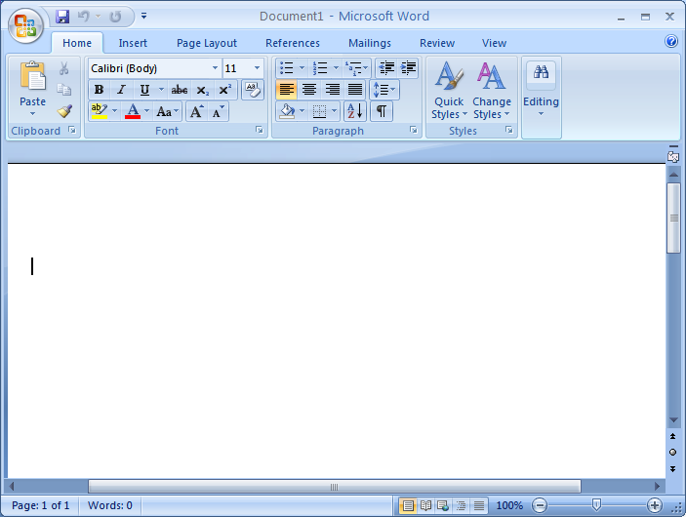

Windows Applications
Rich GUI, highly interactive
Consistent look and feel
Event Driven
SDI Application
MDI Application
Tool buttons
Menu
Selecting Menu
Editing
Notes:
Applications can be categorized as console based, web based, window based, web services, WPF, WCF, mobile applications and so on. This chapter will cover window based applications.
Rich graphical user interface (GUI) applications can be created using Winforms available in .NET framework.
Windows based applications are easy to use as window has a consistent look and feel. Many of the commonly used menu items are also same. Window is a container object and all other objects like menu bar, status bar, tool bar, buttons, etc. are common user interface objects.
Window applications are of two types – Single Document Interface (SDI) and Multiple Document Interface (MDI). Notepad, MS Paint, etc. are SDI applications. User can work with only one document at a time. MS Word, MS Excel, etc. are MDI applications. User can work with multiple documents in MS word multiple workbooks in MS Excel.

Slide 5
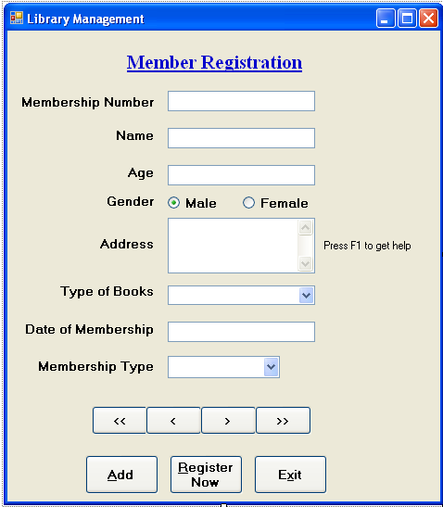
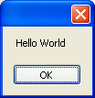
Windows Application in .NET - Winforms
Form is a container object.
Controls, components are a part of the form – contained objects
E.g. textboxes, button, menu bar, tool bar, drop down box, Timer, etc.
Dialog Boxes are also windows in an application to accept user input and display messages.
Common Dialog Boxes like Open File Dialog, Font Dialog, etc.
Customized Dialog Boxes can be created as per application’s requirement
Output
Notes:
Windows Applications in .NET
System.Windows.Forms namespace contains the core functionality for creating windows based applications.
Classes representing different controls like Buttons, TextBoxes, ListBoxes, Label, MenuStrip, etc. are present in this namespace. A window is represented by a class Form in .NET. It is the container object. It can contain controls to make rich user interface.
All controls are derived from Control class. Many of these can be configured at design as well as run time. Components can also be a part of a form. They are not derived from Control class but add to the visual effects of the form. Some of them like the Timer can be visible and configured at design time but are not visible at runtime.
Dialog Boxes like the ones which can be seen as error message windows can be created. Some standard dialog boxes like font dialog box, color dialog box, file open and save dialog boxes are also available in the form of common dialog boxes. These help to provide consistent look to the user.

Slide 6
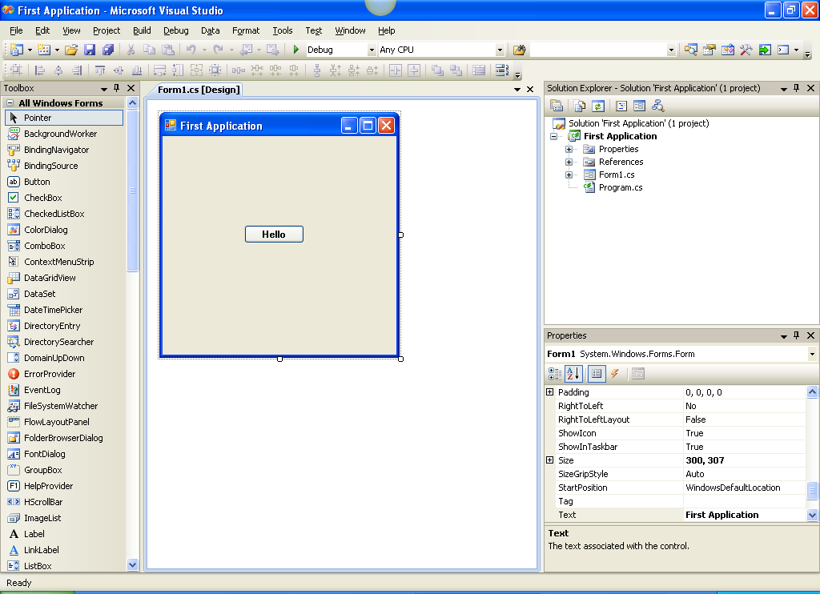
A Simple Winforms Application
Toolbox
Properties – of a particular control(Select the control & press F4)
Design View
Notes:
A Simple Winforms Application
To create a windows application in .NET, project template “Windows Forms Application” is selected. A form object is seen in the design mode. Some namespaces are by default included of which System.Windows.Forms is one of them.
In the image shown above on the slide, a button is dragged from the tool box (contains different tools required to create a rich user interface (UI) and dropped on the form. Actually dragging and dropping the button is creating a new object of Button class. It can be created through code also using new keyword.
If this simple application is executed, above form is seen. If the button is clicked, nothing will happen as no code is written.

Slide 7

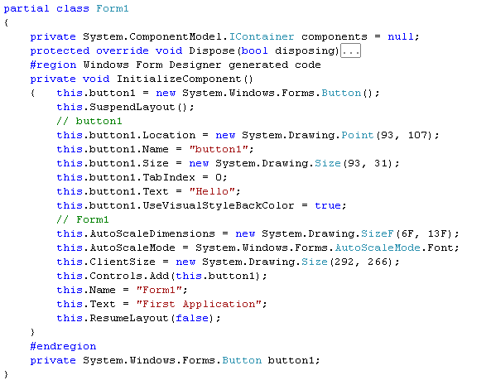
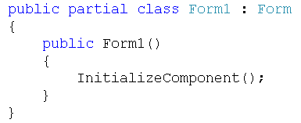
A Simple Winforms Application
Program.cs
Form1.Designer.cs
Call to constructor
Form1.cs
Call to initiailze the components
Button object created
Notes:
A Simple Winforms Application
When the “Windows Forms Application” template is selected, some code is auto generated. It contains following features:
Form1 is the class that inherits from Form class. “partial” keyword is used to define the class. It enables different developers to work on the same class in two different files. This keyword helps in adding functionality to the already existing auto-generated code. There are two files related to form object– Form1.Designer.cs and Form1.cs.
Form1.Designer.cs file contains the code related to the design of the form. Whenever any object is dragged and dropped, an object declaration and its instantiation code is present in this file. It also contains the size, location and name of the object. It also contains the properties of form object. It is present as a part of InitializeComponent() method.
Form1.cs file contains the C# code – event handlers( code that handles events like Clicking of button) and other method. It also contains constructor that uses InitializeComponent() method.
2) The entry point of application is Main() method. It contains following line of code:
Application.Run(new Form1());
Application class represents an application. Its Run() method takes an instance of the Form1 class. This object is the start up form when the application is executed.

Slide 8
Event driven applications
GUI Applications are built on events.
Events are notification that some action has occurred.
Action can be clicking a button, selecting a menu item
Form, controls, components have respective events defined in their class.
Event Handler is written in the application using the event.
Code that is executed automatically when the event is raised, is called an event handler.
Customized as per the requirement in an application.
Notes:
Events
Consider an example of login screen. When the user clicks the button after entering the password, clicking is an action performed and “Click” is an event. In a GUI application, user can interact with the window as per his requirement. The user can click a button, select a menu or type in the editor. Each action that is performed is an event. In this case, clicking, selecting a menu item or pressing key while typing is an event. In short, GUI applications are event driven.
Events are notification that some action has occurred. Events are not necessarily raised by the user but can also be raised by the program code. Forms and controls have their own events. Forms and controls have a pre-defined set events defined. “Click” event is defined in the Button class. They are handled by the client code that uses these classes.
For example, a button object is a part of a form object. Some action is performed in response to the clicking of the button. This is a customized behavior depending on the requirement of the application. In some cases it may be just a printing of some user friendly message while in another case it may be validating a password. So the client code that uses a button object has to define the functionality associated with the clicking action. This code is called event handler code. This code is automatically executed when the user clicks the button.

Slide 9
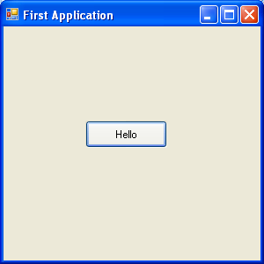

Event driven applications
Event handling in .NET is done using delegates.
Delegate binds the events to methods.
Method is the event handler code
Event attached to a method using delegate
Output
Notes:
Handling events in .NET
Events are handled using delegates in .NET. Delegate is a reference to a method. Event handler is written in the form of a method. A delegate binds the events to methods. So when a button is clicked, automatically the code is executed.
Following line of code can be added in the form before the event is likely to be generated (either in the designer window or load event of the form)
this.button1.Click += new System.EventHandler(this.button1_Click);
EventHandler is a delegate that represents the method that will handle an event that has no event data.
private void button1_Click(object sender, EventArgs e)
{
MessageBox.Show("Hello World");
}
button1_Click is the name of the method which gets called when the button “button1” is clicked. MessageBox is a class used to show a message box. Show() is a static method. First parameter is a reference to an object that raised the event. Second parameter is used to pass state information of the event.
Similarly events of form and other controls can also be handled. For example, when the form gets loaded into memory, load event is fired. Code that is required to get executed while the form is getting loaded is written in this event.
Delegate is added first.
this.Load += new System.EventHandler(this.Form1_Load);
Method or event handler is written.
private void Form1_Load(object sender, EventArgs e)
{
. . . // code here
}
Note: One method can be associated with multiple events. The method name has to be passed as a parameter to the delegate. For example, button_click () can be associated with button1 and button2 objects.

Slide 10
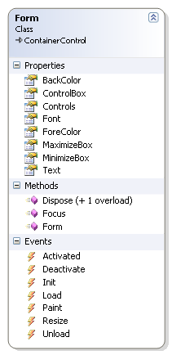
Windows Form
Form class defines many members
Properties
AcceptButton
CancelButton
MaximizeBox, MinimizeBox
IsMdiChild and so on
Methods
Show()
ShowDialog()
LayoutMDI() and so on
Events
Load
Click
MouseDown, MouseMove, MouseUp
KeyDown, KeyPress, KeyUp and so on
Notes:
Windows Forms
Windows Forms is represented by Form class. Any form that is created inherits from the Form class. Form class defined a number of properties, methods and events. (Life cycle of form covered in the next slide).
Some of them are mentioned on the slide.
AcceptButton property helps to get or set any button on the form that is clicked when the user presses the enter key. For example, OK button in normal scenario is mapped to enter key. CancelButton property helps to get or set any button on the form that is clicked when the user presses Esc key. If the developer does not want the form to be maximized or minimized, MaximizeBox and MinimizeBox property can be set to false. IsMdiChild, ActiveMdiChild and IsMdiContainer properties are used in context with MDI applications.
Show() method helps to display the form. ShowDialog() displays the form as a modal dialog box (covered later in the chapter). When this method is used, code written after this statement is not executed till the user acknowledges the dialog box by clicking some button. LayoutMDI() arranges the multiple-document interface (MDI) child forms within the MDI parent form.
Load event is fired when the form gets loaded in the memory. Paint is fired when the form is redrawn. Click is fired when the user clicks on the form. Mouse events such as MouseDown, MouseOver and MouseUp events are fired in response to mouse actions.

Slide 11
Form Life Cycle
Form object has its own life cycle.
Load
Paint
Activate
Deactivate (in case of MDI application, it may be required)
Closing
Closed
There are many other events in the life cycle of the form which can be handled as per the need of the application.
Notes:
Form Life Cycle
Every object has a life cycle. Similarly form object also has its own life cycle. When Application.Run(new Form1) statement is executed, new object of Form1 class is allocated on managed heap. Here the life cycle of form object starts.
Loading of form in memory fires or raises Load event. In this event, developer can write code related to configuring the look and feel of the form, child controls (like textbox, label, list box, etc.), allocating resources like connection to a database, etc.
Paint event is fired when the form is redrawn.
When the form gets the focus or is active, Activate event is fired. After the form is active again Paint event is fired to redraw all the controls present on it. Deactivate is fired when the form is deactivated or loses focus (in MDI application).
Closing event is fired when the form is being close. The developer can use this event to get the confirmation about the closure of the form from the user. The user may like to save the data if it is not saved.
Closed event is fired after Closing event. Application exits and unloaded from the memory. Properties window does not list these events. They have to be manually added in the code.
this.Closing += new EventHandler (form_closing);
this.Closed += new EventHandler (form_closed);
There are many other events defined in the Form class.

Slide 12


Windows controls
Control | Description
Label | Provides descriptive text for a control
TextBox | Accept value from the user or display it
Button | Performs some action when clicked
CheckBox | Helps to select multiple options in form Yes or no
RadioButton | Helps to select single options
ComboBox | Displays data in drop down box
ListBox | Displays a list of items and allows multiple selection
ErrorProvider | Shows the user in a non-intrusive way that something is wrong
HelpProvider | Provides pop-up or online Help for controls.
ToolStrip | Helps to display toolbar objects
MenuStrip | Displays commands logically grouped together
GroupBox | Provides identifiable grouping for other controls
StatusStrip | Displays status information
Notes:
Windows Controls
Windows controls are derived from Control class. This represents controls and components with visual representation. These controls help to display information to the user, accept any value from the user, etc.
Some of the common controls are shown on the slide with small description.
Label helps to display descriptive text for the controls. It can display images also. The text cannot be edited by the user. But code can be written that changes the text at runtime.
TextBox allows to edit text. It is used to accept or display some information from the user. It provides faciltiy for the text to be in single format. By default only single line text is allowed but it can be changed to multiline.
Button is used when some action needs to be performed when it is clicked. For example, on the click of Ok button, application should be exited.
CheckBox allows multiple selection of options from a group of options.
RadioButton allows only single selection at a time among a group of RadioButtons. If there are multiple logical groupings on the form then GroupBox is used.
ComboBox is a combination of textbox and ListBox. It occupies less space than ListBox. Multiple selection is not allowed.
ListBox allows multiple selection and occupies more space. Editing is not possible at runtime. ComboBox and ListBox store collection of items.
ErrorProvider is used to validate the input in a form or a control. It is better than providing message box because error is not visible once message box is clicked.
HelpProvider provides help on a control when the uses presses F1 key.
ToolStrip
MenuStrip can be used in SDI as well as MDI applications. Short cut keys can be given to the menu and sub menu items and corresponding events can be defined.
GroupBox gives a logical view to the user. It helps to group similar types of items together.
StatusStrip can be used to show the status. For example, status of CapsLock key, line number, progress of the task, etc.

Slide 13
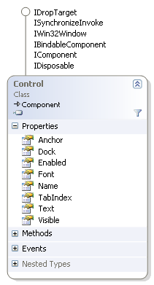
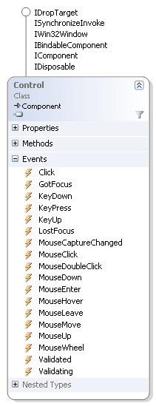
Common properties and events
Common properties and events of all controls are defined with the base class – Control class
Notes:
There are some common properties and events that are associated with every control. These are defined by control class.
Some common properties are :
Name - gets or sets the name of the control. This is unique for each control.
Dock – gets or sets the control borders docked to its parent.
Visible – gets or sets the visibility of the control on the form. It is a boolean property.
Enabled – enables the control
Font – sets the font for the control
TabIndex – gets or sets the tab order of the control within its container.
Some common events are categorized as
Mouse events – MouseDown, MouseOver and MouseUp
Key events – KeyDown, KeyPress and KeyUp
Validation events – Validated, Validating
GotFocus and LostFocus – GotFocus occurs when the control gets the focus. LostFocus occurs when the control loses focus.

Slide 14
Validation in Window Forms
Validation is the process of checking input from the user and making sure it is given properly, based on some criteria. Examples of validation checks include
Checking for required input in a particular field
Checking whether input data is a valid numeric value
Checking for input to be within some range of values
Checking for particular patterns within an input string
Invoking complex business rules that check dependencies between other business entities and values in your application

Slide 15
Handling Validation Events
Every Windows Forms control exposes two events,
Validating
Validated
They inherit from the base “Control” class.
The Validating event is intended to fire immediately after input has been completed, but before it has been accepted as valid.
The Validated event fires after the input has been accepted as valid.

Slide 16
Handling Validation Events
The Validating event is handled most often for data-binding scenarios.
When a control decides that input is complete, typically because the focus is shifting to another control on the form, it should fire the Validating event.
This event is of type CancelEventHandler, which takes an event argument of type CancelEventArgs.
The CancelEventArgs class contains a single Boolean property named Cancel that you can set to signal that the event being fired shouldn't be completed.
Setting Cancel to true is a signal back to the control that validation failed in the code that handles the event.

Slide 17
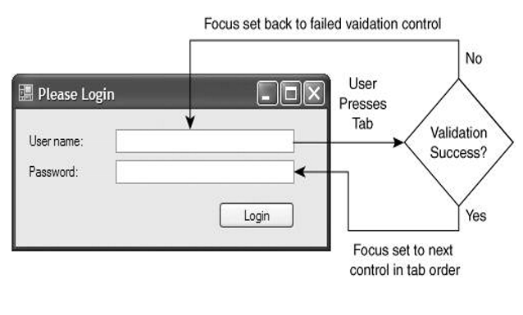
Control Validation Events

Slide 18
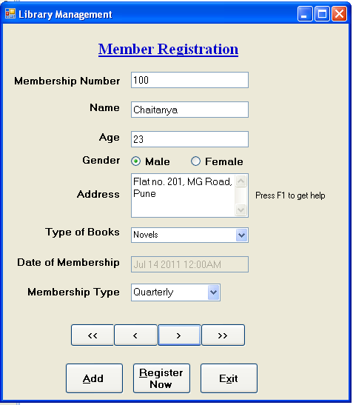
Validation of controls
Validations to be performed
Membership number is mandatory (use ErrorProvider)
Name entered should have only alphabets
Age entered should be numeric
Help should be provided on address field( Use HelpProvider)
Minimum one type of the book should be selected
Date of membership should current date
Membership type should be populated in the combo box at run time.
Notes:
A simple form can be designed as displayed on the slide. The form displayed shows member registration in a Library Management System. The form shows labels, text boxes, check boxes, radio buttons, combo box, list box. The form accepts the information about a new member being enrolled.
Validation of Controls
When the information is accepted from the user, correctness of values should be ensured by the developer. End user has to be informed about the values to be entered. This can be done by setting some properties, using controls like ErrorProvider and HelpProvider or using certain events to do the task.
In the form shown above, some validations are done using the same.
Membership number is associated with ErrorProvider (either by using Error on ErrorProvider property of the text box or by writing a code as mentioned below) so that it becomes essential for the end user to enter the number. The ErrorProvider blinks till the user fills the information.
private void txtMemNo_Validating(object sender, CancelEventArgs e)
{
if (txtMemNo.Text == "")
{
epMno.SetError (txtMemNo, "Please enter Membership number");
}
else
{
epMno.SetError(txtMemNo, "");
}
}
To accept the name of the member in the form of only alphabets and spaces, KeyAscii event is handled. The KeyEventArgs argument provides important information about the KeyPress event. KeyAscii value can be checked for getting alphabets and spaces, else an error message is displayed.
3. Age accepted should be numeric. In this case too KeyPress event is handled.
4. HelpProvider is provided for the address TextBox. Help string is entered in the “HelpString on HelpProvider” property of the HelpProvider and then this is associated with the text box using its property.
5. Minimum one selection is required for the “Type of books”. So the code is written in the validating event.
6. Date of membership has to be current date. It is displayed using the DateTime class. The text box is disabled. Load event of the form is handled.
txtMemDate.Text = DateTime.Now.Date.Day + "/" + DateTime.Now.Date.Month + "/" + DateTime.Now.Date.Year;
7. The combo box can be populated at design time using the items property of the control or writing a code in the Load event of Form.

Slide 19
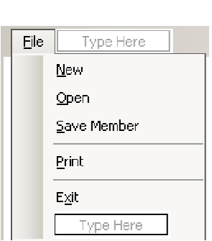
Steps to Create a MenuStrip
In the Toolbox, expand the Menus & Toolbars category. Drag a MenuStrip control anywhere onto the Form.
The control, by default called menuStrip1, appears at the bottom of the form, and a menu strip containing the caption, “Type Here”, is added to the top of the form.
Click the “Type Here” caption on the menu strip, type &File, and then press Enter.
When you click the “Type Here” caption, a second “Type Here” caption appears to the right of the current item, and a third “Type Here” caption appears under the File menu item.
Click the “Type Here” caption that appears under the File menu item, type &New, and then press Enter.
Repeat the process until you create a MenuStrip as shown in the Figure.

Slide 20
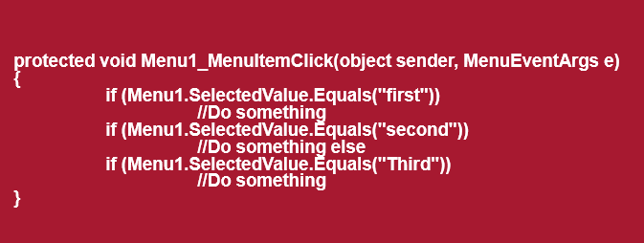
Menu Event Code

Slide 21
ToolStrip
ToolStrip usually provide access to features that are also accessible through menus, but there's a tradeoff.
A ToolStrip is always visible, it can be clicked without having to navigate through a menu structure.
Items are normally represented by buttons with a small bitmap.
In Windows Forms, toolbars are represented by the ToolStrip class, and individual buttons on it are represented by the ToolStripButton class.

Slide 22
StatusStrip
A StatusStrip is ideal for displaying small amounts of information throughout the life of the application.
This information should never be critical or take the place of informative messages or progress indicators, as many users won’t notice it.
Some possible StatusStrip information includes:
Information about the application mode or operating context.
Information about the application status.
Information about a background process.
Information about the current document.

Slide 23
Creating MDI Applications
MDI (Multiple Document Interface) is nothing but a way of displaying Windows Form where there is at least one parent and many child Windows.
Ex: MS Word, Excel, PowerPoint kind of windows, where each document, sheet or slide act as a child under the parent container window.
SDI (Single document Interface) examples are Windows Explorer, Internet explorer, Notepad etc...where only one window acts as an interface.
Notes:
Steps to create an MDI Application
• Goto File->New->Blank Solution
• Select Visual C# Projects in Project Types
• Select WindowsApplication in Templates
• Create a project
• From Project Menu select AddNewItem
Select Windows Form
• Type for eg. myBestMDI in the Name textbox
• After the from created go to property window and change IsMDiContainer property to true
• The above window will be converted to MDI
Creating the child
• Goto Project Menu-Add Windows Forms & type frmSChild
• In the Solution Explorer now doubleclick frmSChild
• Locate the property Text and type "This is the Single Instance Child“
• Locate the property size & set it to 568, 464
Code:
frmSChild child =new frmSChild();
child.MdiParent =this;// set the child form parent form property to MDI form
Child.Show();

Slide 24
What is data binding?
Controls on Winforms can be bound to any data structure that contains the data
Array, Collections, traditional data sources like databases, files, etc.
Text property of TextBox can be associated to a field in the database to display something.
Any property of the control can be set to the data source at run time using the feature data binding
Using ControlBindingsCollection
DataBindings property is used
Every form has a BindingContext object.
It manages binding objects that are bound to the same data source and data member.
Notes:
Data can be stored in an array, collections like ArrayList, databases or files. This data can be associated with a control on a form. This is called data binding.
Any property of the control can be set to the data source at run time using the feature data binding. This feature is useful to bind the data.
Every form has a BindingContext property. This internally manages the collection of binding objects that bind to the same data source and data member. It actually synchronizes the data obtained from multiple fields from the table into the controls on the form for a particular record.
The controls are bound to the data using DataBindings collection. The property of the control that needs to be bound, data source and the property or the list to bind is passed as a parameter.

Slide 25
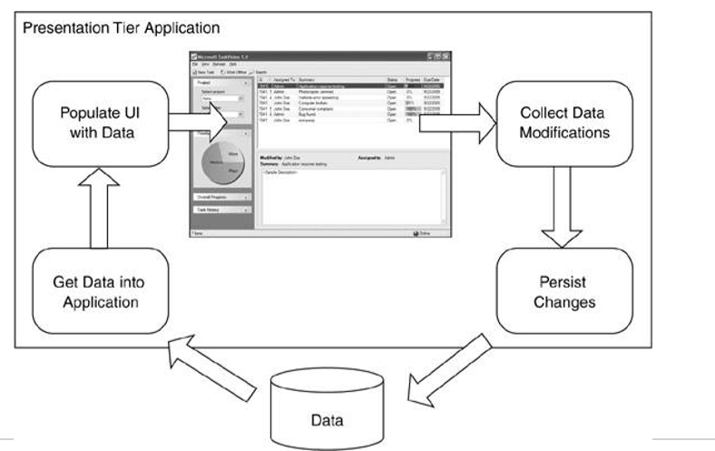
Data Binding Process

Slide 26
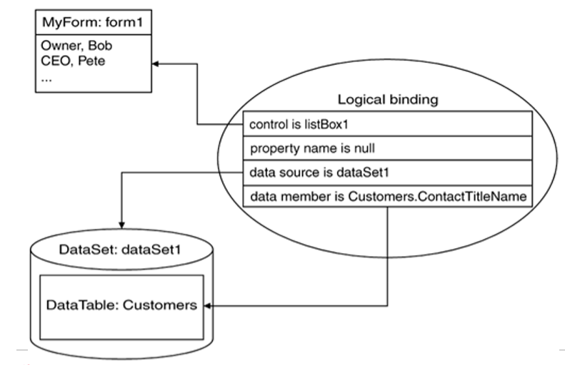
Data Binding Types – Complex

Slide 27
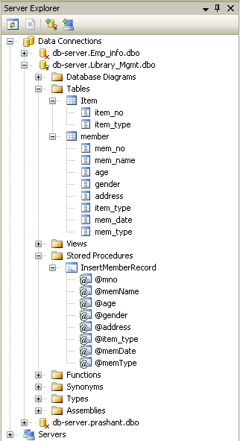
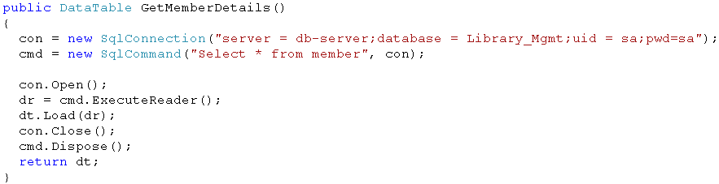
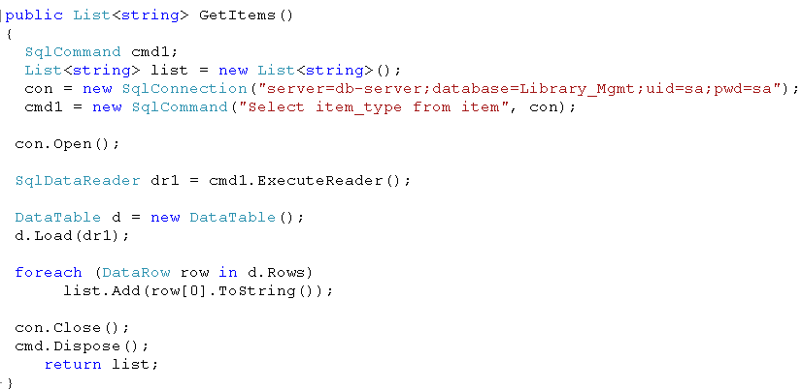
Creating Database, Tables and Methods
Item & Member tables with field names
Methods in Library_Mgmt class to interact with the database
Stored Procedure
Notes:
A database by name “Library_Mgmt” needs to be created and server name is db-server to be given. Table by name “Member” and “Item” are created. The names of the fields are shown above. Stored procedure by name “InsertMemberRecord” is created to insert a record of new member. Stored procedure are faster than firing SQL statements as they are stored in the database in pre-compiled form.
A class named “Library_Mgmt” is created that interacts with the database. It contains two methods – “GetMemberDetails” and “GetItems”. First method helps to fetch the data into DataTable. This DataTable acts a source of data to the controls on the form. Individual fields are displayed in the respective controls. Second method retrieves the list of items from the “Item” table into List<T> collection. This list reference returned acts as a source of data to the ComboBox and the ComboBox gets populated.

Slide 28
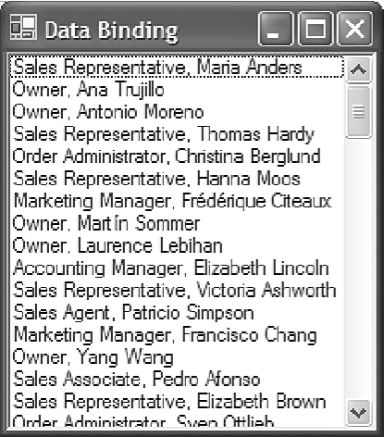
Complex Data Binding - Example

Slide 29





Data Binding
Adding data bindings to controls
BindingContext helps in navigation by moving the record pointer internally
Method of a Libarary class that retrieves collection data from the data base
Binding a ComboBox with a collection using DataSource
Notes:
Check the link provided to see the application.
The member registration form has navigation buttons and a button to insert a record. The data is present in the database. When the “Register Now” button is clicked, the call to the stored procedure is given. The data is sent in the form of SQLParameter object. CommandType enumeration is mandatory in case of stored procedure.
ComboBox is populated with the items from the master table “Item”. This ensures only valid data to be displayed in the ComboBox. For this purpose DataSource property of the ComboBox is used to associate it with the list collection returned from the GetItems() method.
Every form has its own binding context. This property takes a data source as a parameter. It helps in the synchronization of data bound controls on the Windows Form that are bound to the same data source. For example, in order to get the details of a member on the membership registration form, data in all the controls should belong to the same member. CurrencyManager class helps to maintain the record pointer internally. So the code on the slide uses Position property to navigate to a record and display the details.

Slide 30
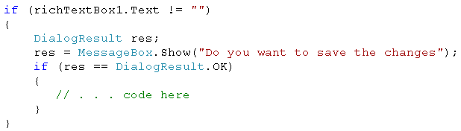
Dialog Box
Used to display messages or accept some data in the application.
Customized as per the need of the application
Types of Dialog Boxes
Modal – e.g. message box that displays error in an application
Modeless - e.g. Find-Replace utility of MS Word
Custom Dialog Boxes can be created
Created using a form object – ShowDialog() method is used
Common Dialog Controls
FontDialog, ColorDialog, OpenFileDialog, etc.
ShowDialog() method is used
Notes:
Dialog Box
Dialog box is used to display a particular message to the user or to accept some information. This can be customized as per the need of the application. Message box displayed using Show() method of MessageBox class is used to display messages. Dialog Boxes are of two types:
Modal Dialog Box – A dialog box which requires to be acknowledged first then the user can work with the application, is called a modal dialog box. Dialog Box that displays error messages or any other messages are modal dialog boxes.
Modeless Dialog Boxes – A dialog box which does not require itself to be acknowledged and the user can work with the application is called a modeless dialog box. Find-Replace utility of MS Word is an example of modeless dialog box.
Custom dialog box can be created. A form is created. ShowDialog() method is called. It returns reference of DialogResult. DialogResult is an enumeration. Depending on the values returned, action can be taken.
Common Dialog boxes like File Open and Save dialog boxes, FontDialog box, Color Dialog Box, etc. can be used in an application. It gives a consistent look of windows in an application.

Slide 31
Reference
For more details, please visit
http://www.codeproject.com
http://msdn.microsoft.com/en-us/library
Notes:
Reference

